Slide 1
Novel Molecular Dynamics Simulations of Ionic Liquid-Based Interfaces
Brian C. Perea
Chemical Engineering
ASU/NASA Space Grant

Slide 2
Outline
Introduction to ionic liquids
Motivation
Introduction to Molecular Dynamics simulations
Novel MD simulations of immiscible ionic liquids
Future work
Notes:
Introduction to ionic liquids
Unique properties
Potential applications
Motivation
Introduction to Molecular Dynamics simulations
What they are
How they work
Novel MD simulations of immiscible ionic liquids
Recent findings
Future work

Slide 3
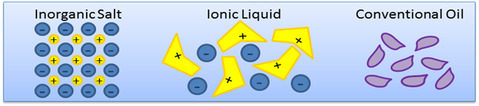
Ionic Liquids
Molten salts
  Organic ions
  Steric hindrance

Slide 4
Unique Properties of Ionic Liquids
Negligible volatility
Thermal stability
High ion conductivity
Magnetic response

Slide 5
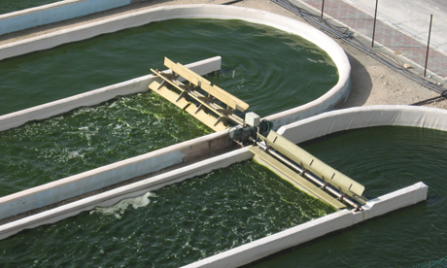
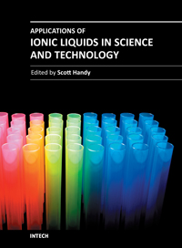
Applications of Ionic Liquids
Processing of biomass
  Cellulose
  Algae
Gas handling and treatment
  CO₂ capture
  Transport of reactive gases
Solar thermal energy systems
Waste recycling

Slide 6
Motivation
Analogy to oil/water emulsions
  Ubiquitous
  Highly diverse applications
  The utility of emulsions
If ionic liquids are to be the cutting edge technology we need to understand their mixing behavior
Notes:
If ionic liquids are to be the cutting edge technology we need to understand their mixing behavior

Slide 7
Introduce MD Simulations
How do they work?
  Successive energy minimization
Why are they special?
  Molecular resolution
  Prediction of experimental properties
Limitations
  Molecule size
  Timescale

Slide 8
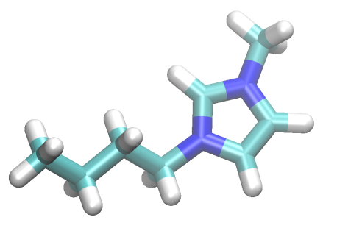
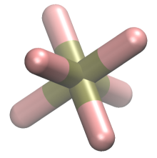
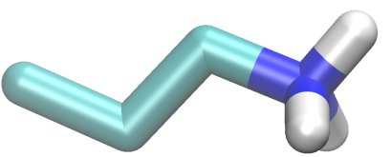
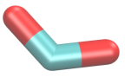
Our system
[BMIM] [PF6]
1-butyl-3-methylimidazolium
hexafluorophosphate
[PAM] [FOR]
propylammonium
formate

Slide 9
Our system
Can study effects such as chain ordering (PAM)
Density profiles can be used to study interfacial properties
Compare density, interfacial tension, and other properties to experiment

Slide 10
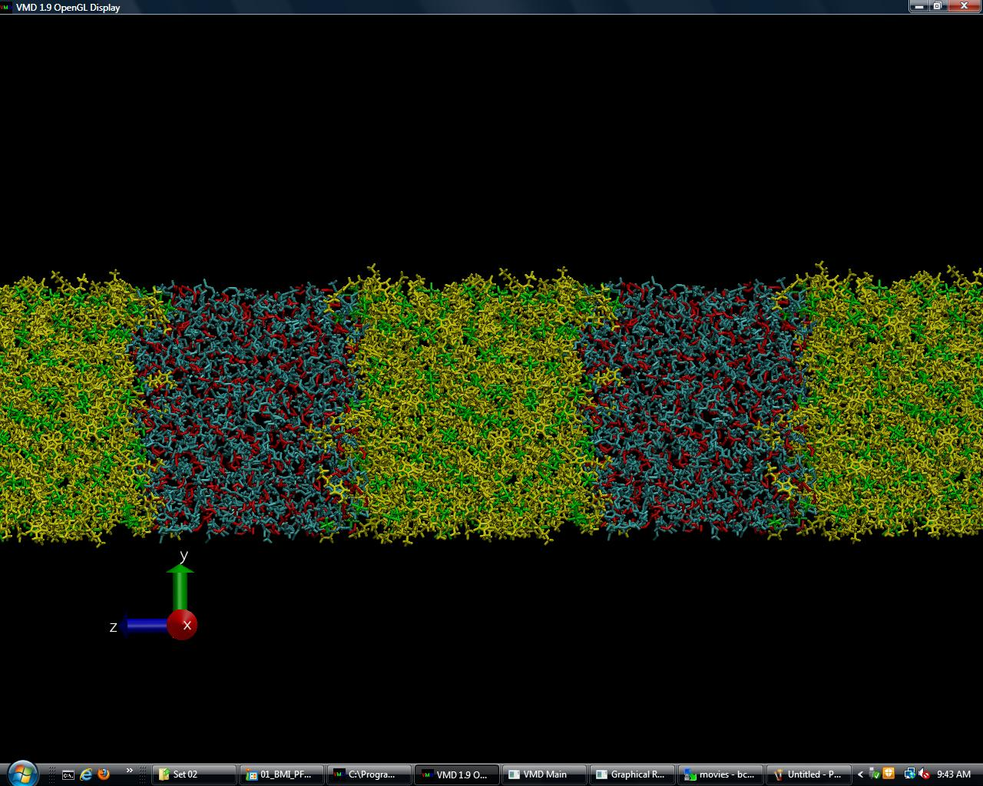

Slide 11
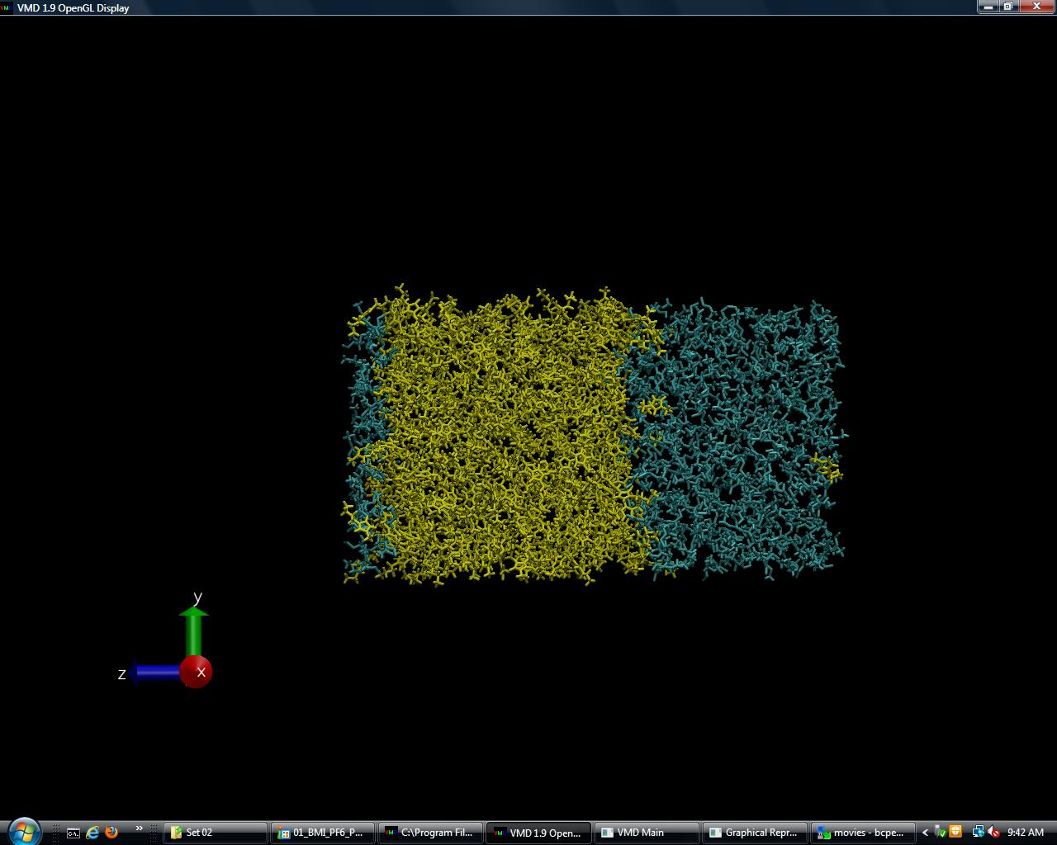

Slide 12
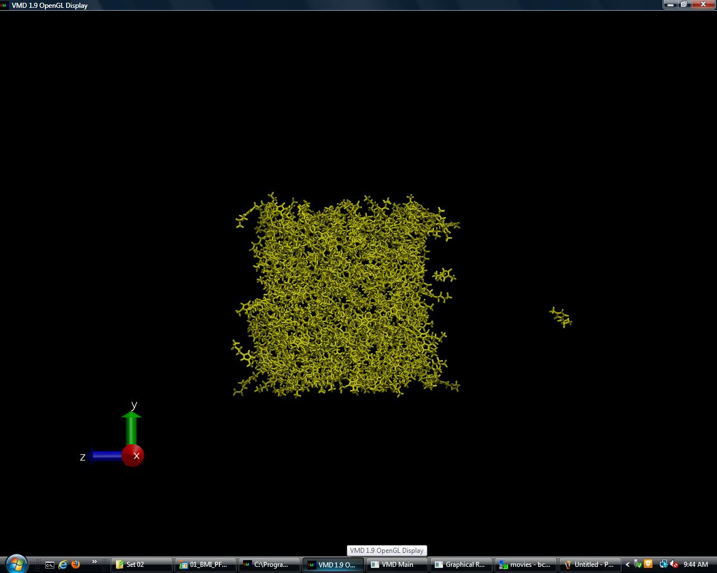

Slide 13
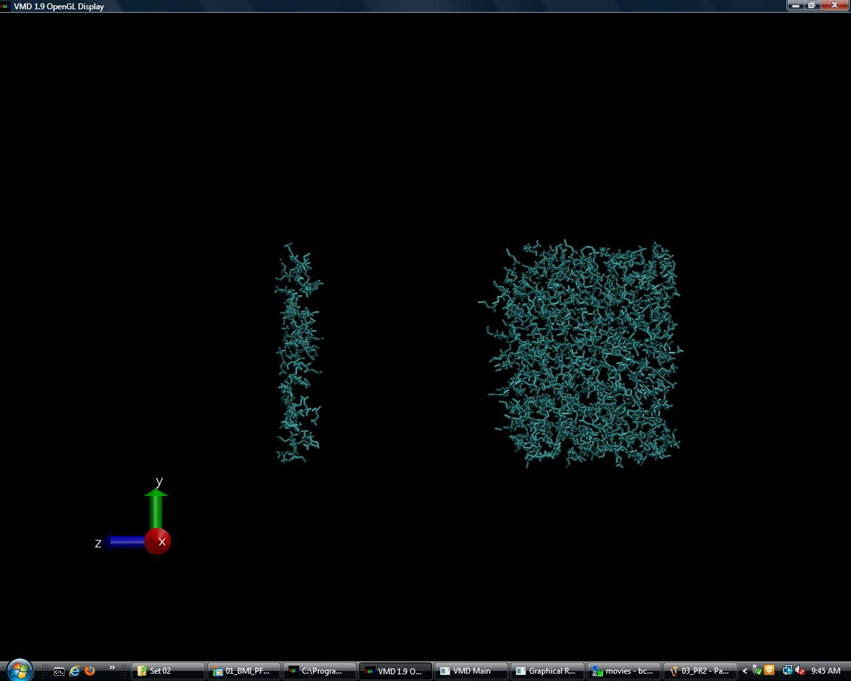

Slide 14
Future work
Synthesize ILs experimentally
Characterize IL interface experimentally
Compare to simulations

Slide 15
Acknowledgments
Professor Lenore Dai
Denzil Frost
ASU/NASA Space Grant

Slide 16
Questions?

Slide 17
Backup Slides

Slide 22
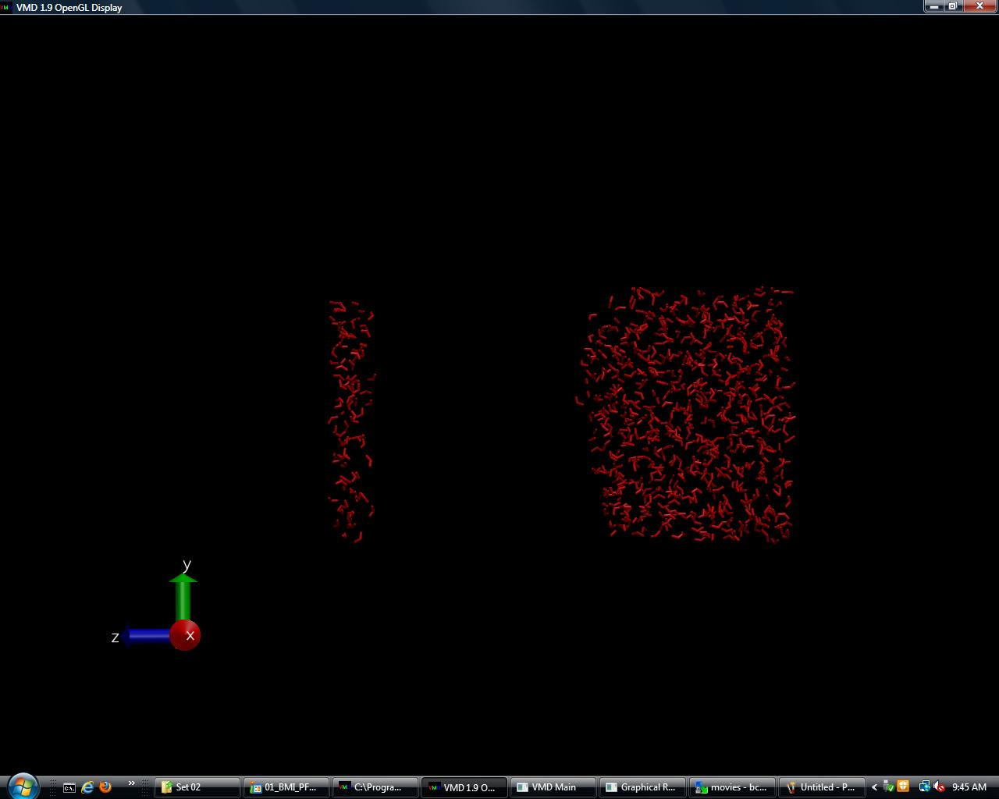

Slide 23
